Slide 1


Slide 2






Slide 3
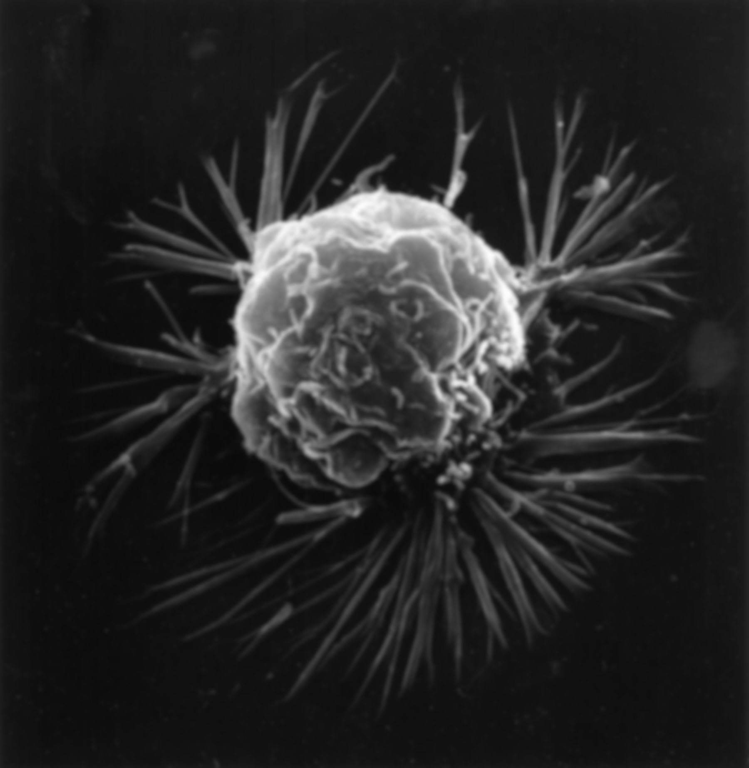

Slide 4



Slide 11



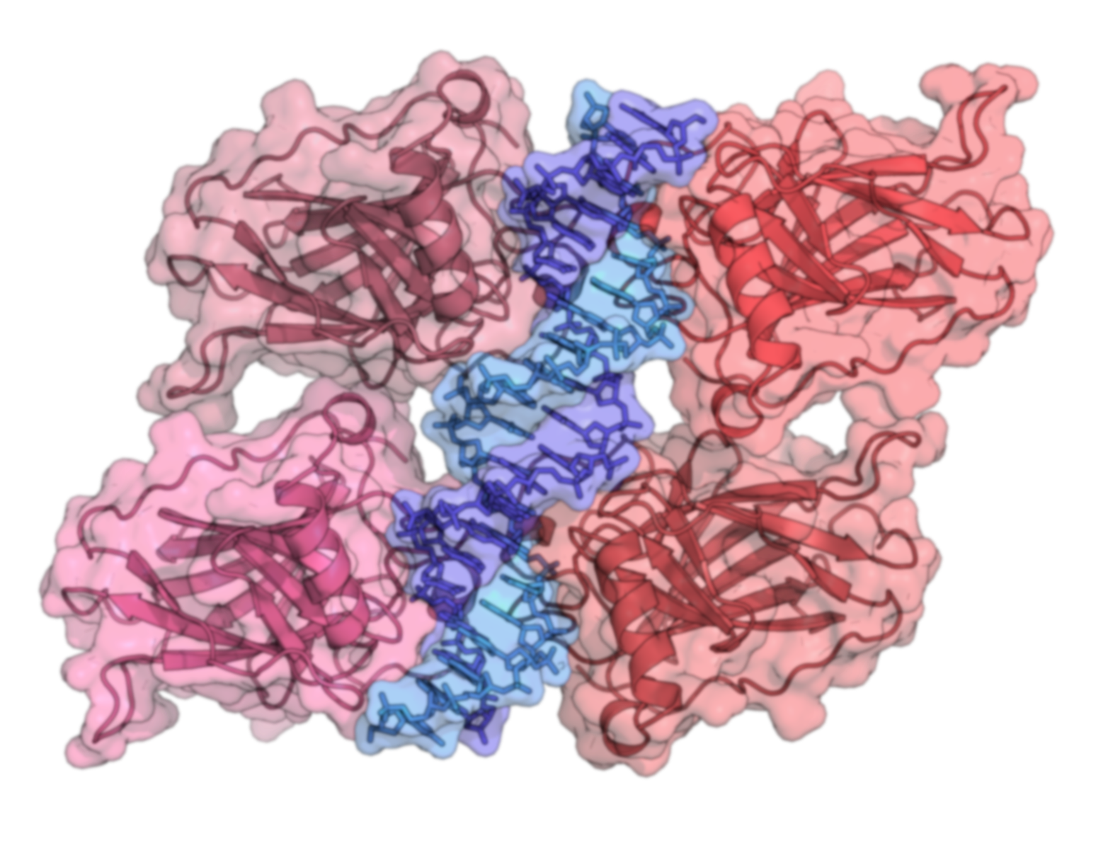
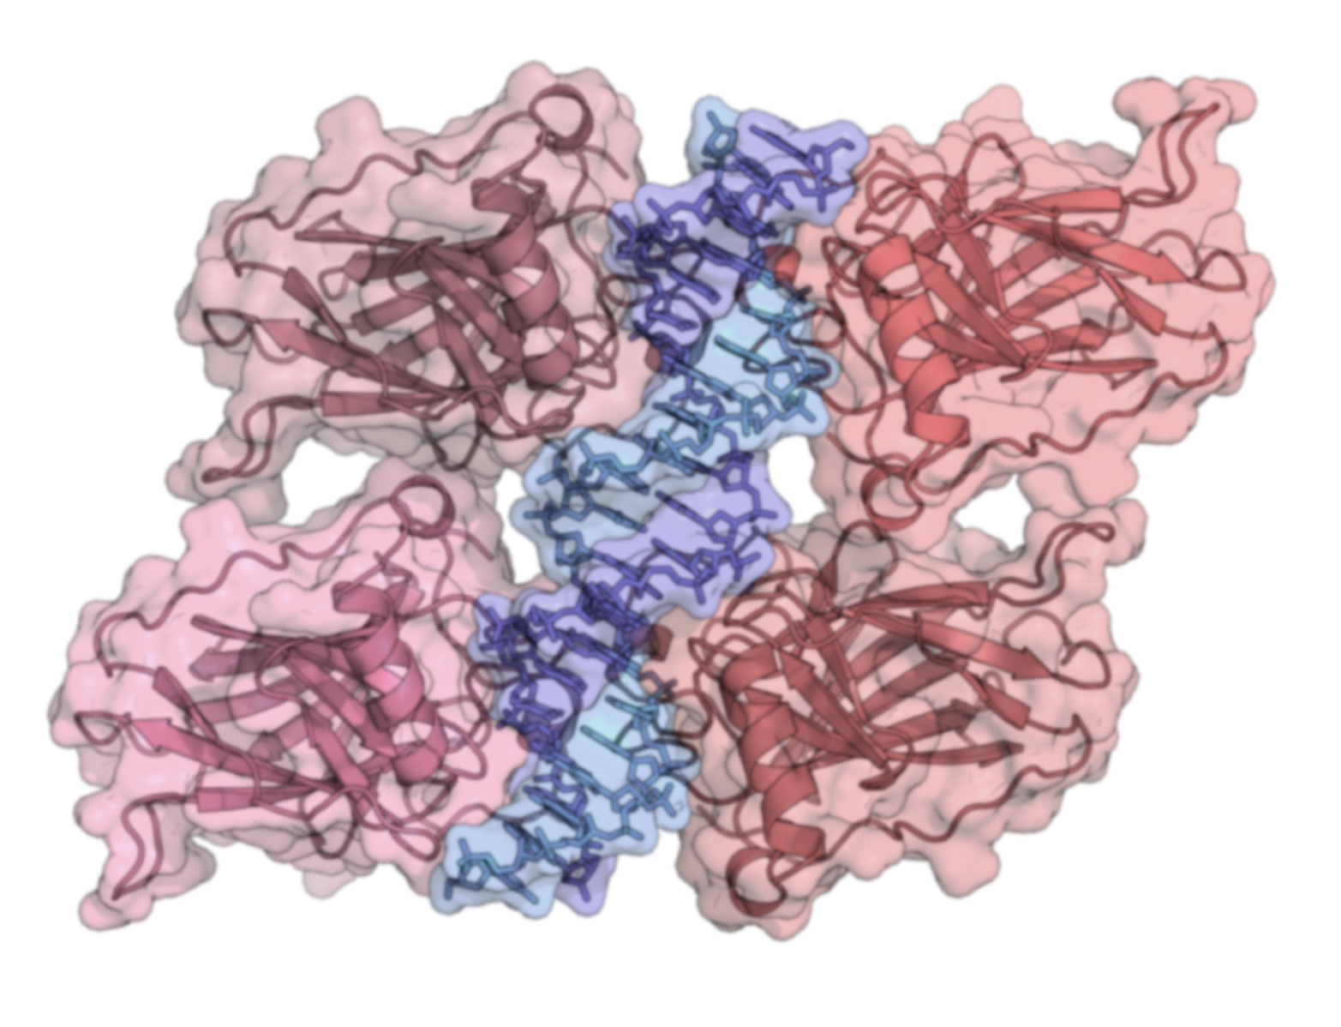

Slide 12



Slide 13


Slide 14
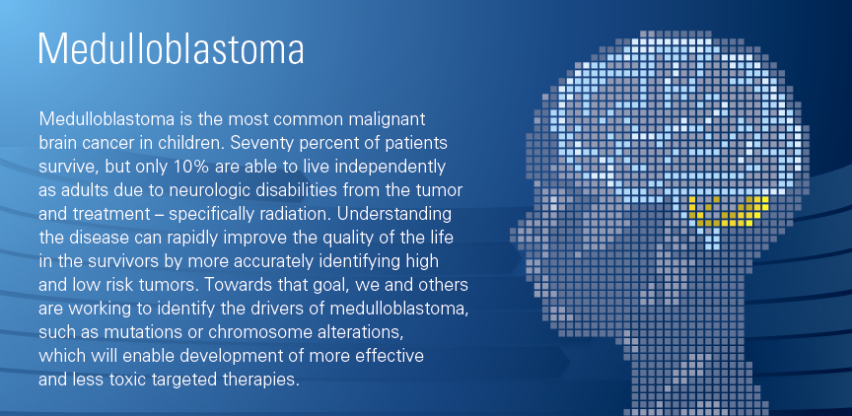

the Mesirov Lab
Computational Cancer Research & Open Source Software Tools
10111000010100100010100100001010
10111000010100100010100100001010
10111000010100100010100100001010

Slide 15

Mesirov Lab

Slide 16
About the Lab
Research in the Mesirov lab focuses on applying machine-learning and statistical methods to functional genomics data with the goal of better understanding the underlying biological mechanisms of disease, improving stratification of patients with respect to different treatment outcomes, and identifying novel drug targets. Our lab is committed to the development of practical, accessible, open source software tools to bring these methods to the general biomedical research community. These tools support the research of hundreds of thousands of investigators worldwide. Thus, to achieve its goals, the lab includes both computational biologists and software engineers working together to further our understanding and treatment of disease.

Slide 17
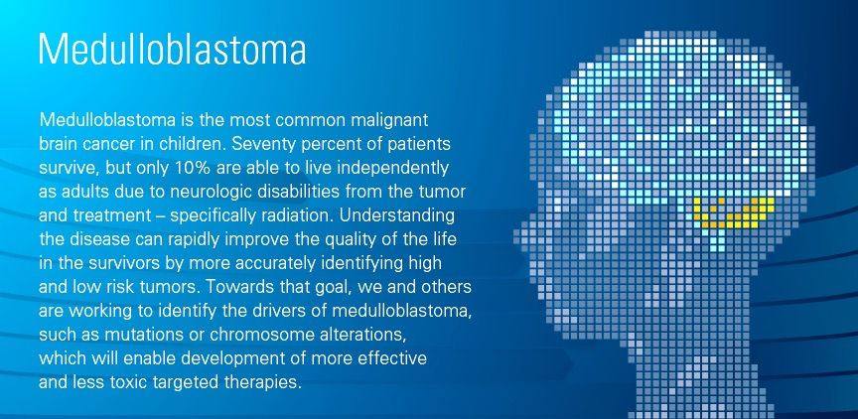
About the Lab
Research in the Mesirov lab focuses on applying machine-learning and statistical methods to functional genomics data with the goal of better understanding the underlying biological mechanisms of disease, improving stratification of patients with respect to different treatment outcomes, and identifying novel drug targets. Our lab is committed to the development of practical, accessible, open source software tools to bring these methods to the general biomedical research community. These tools support the research of hundreds of thousands of investigators worldwide. Thus, to achieve its goals, the lab includes both computational biologists and software engineers working together to further our understanding and treatment of disease. Learn more...

Slide 18


Slide 19
About the Lab
Research in the Mesirov lab focuses on applying machine-learning and statistical methods to functional genomics data with the goal of better understanding the underlying biological mechanisms of disease, improving stratification of patients with respect to different treatment outcomes, and identifying novel drug targets. Our lab is committed to the development of practical, accessible, open source software tools to bring these methods to the general biomedical research community. These tools support the research of hundreds of thousands of investigators worldwide. Thus, to achieve its goals, the lab includes both computational biologists and software engineers working together to further our understanding and treatment of disease. Learn more...

